Slide 1
Python for Data Analytics
Dr. Chaojie (Jay) Wang
2019.08

Slide 2
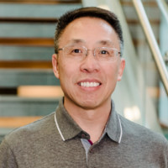
whoami
Chaojie (Jay) Wang, D.Sc.
Principle Systems Engineer, SETC, MITRE
Adjunct Instructor, CSEE, UMBC
wcj365@gmail.com
Linkedin: jaywangusa

Slide 3
The Agenda
1.
Intro
3.
Three Pillars
4. Two Partners
2.
Basics

Slide 4
1. Intro

Slide 5
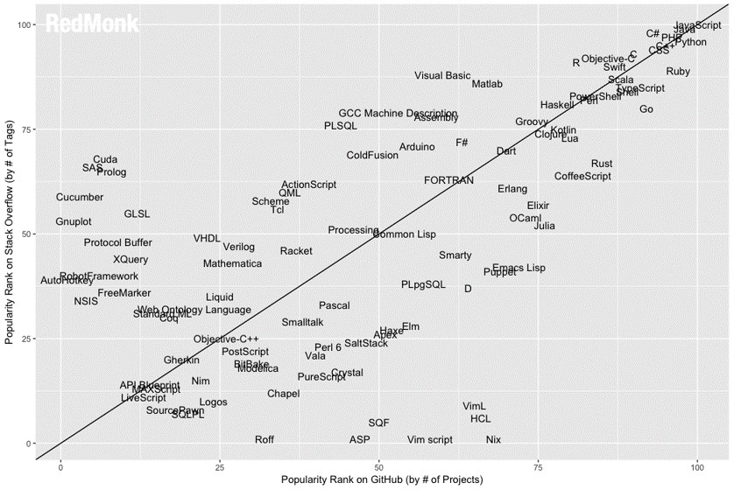
Why Python?
https://redmonk.com/sogrady/2019/03/20/language-rankings-1-19/

Slide 6
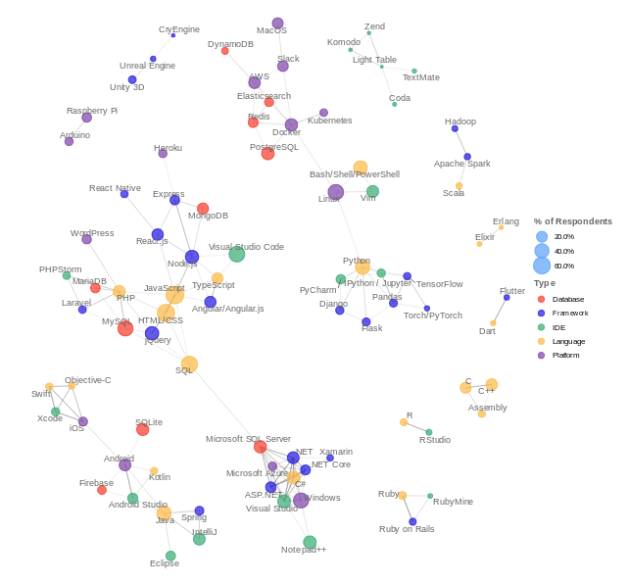
https://codinginfinite.com/top-programming-languages-2020-stats-surveys/

Slide 7
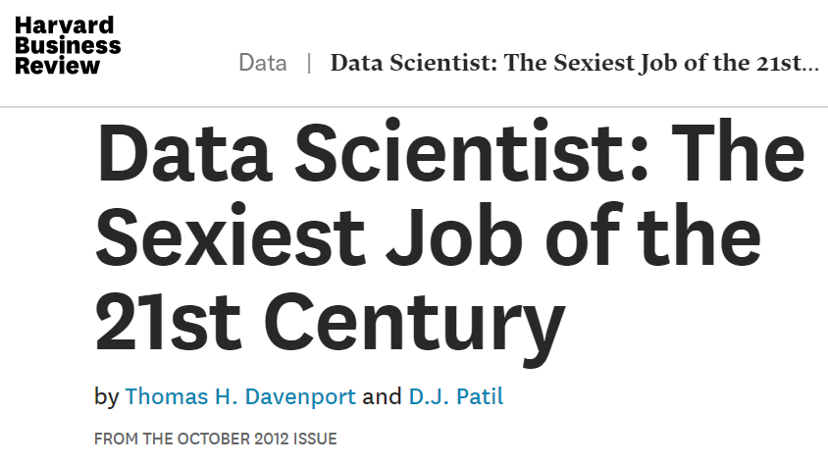
Why Data Science?

Slide 8
Wisdom Hierarchy & Healthcare Analytics
Health
Healthcare
Health
Informatics
Health IT
PHM
Wisdom
CEO
Risk Factors & Prevention
Know why
CDS
Know how
Knowledge
CMO
Symptoms &
Treatment
Information
CIO
Analysis and
meaning of data
Know what
Know nothing
Data
CTO
Collection and
sharing of data
PHM – Population Health Management CDS – Clinical Decision Support

Slide 9
Statistical Inference vs Machine Learning
Statistical Inference
- Mathematical Proof
Significance of the effect
Machine Learning
- Computational Power
Prediction
If it predicts, it works
Size of the effect
Don’t ask me why
Relationship/association
https://blog.thedataincubator.com/2017/11/scikit-learn-vs-statsmodels/
https://healthcare.ai/machine-learning-versus-statistics-use/
https://towardsdatascience.com/the-actual-difference-between-statistics-and-machine-learning-64b49f07ea3

Slide 10
Python Data Analytics Landscape
Seaborn Pandas
Matplotlib
Numpy
Scipy.stats
Statsmodels
Week
11-13
Statistical Inference
Week
9-10
Probability Distribution
Dash
Exploratory Data Analysis
Week
6-8
Plotly Express
Week
4-5
Data Visualization
Week
1-3
Scientific Computing

Slide 11
Python Data Visualization Libraries
Plotly
Plotly Express
- Atair
Matplotlib
Seaborn
Dash
Bokeh
Interactive Graphs
Dashboard
Development
Static
graphs
Low-level API
High-level API

Slide 12
What is Python
General-purpose high-level programming language
Interpreted
Cross-platform
Elegant and simple
No brackets (use indentation instead)
Dynamic typing (no need to define variable)
Object-oriented
But support procedural programming style
Flexible development
Interactive mode
Script mode
Use Interactive Python Shell to Practice from python.org

Slide 13
Resources
Python Tutorial
https://docs.python.org/3/tutorial/
Python 3 Cheatsheet
https://perso.limsi.fr/pointal/_media/python:cours:mementopython3-english.pdf
Think Python 2nd edition
https://greenteapress.com/thinkpython2/thinkpython2.pdf
Python 3 Patterns, Recipes, and Idioms
https://python-3-patterns-idioms-test.readthedocs.io
Python Programing: An Intro to CS by John Zelle
http://citeseerx.ist.psu.edu/viewdoc/download?doi=10.1.1.111.6062&rep=rep1&type=pdf

Slide 14
Tools
Development Environment
Jupyter Notebooks
Web-based IDE
http://repl.it
Desktop IDE
Spyder (install Anaconda)
Web-based Console
http://www.python.org
Kaggle
http://www.Kaggle.com
Microsoft Azure Notebooks
https://notebooks.azure.com/
Google Colab
https://colab.research.google.com/
Jupyter Notebooks integrate code, output, and comments in a single interactive document and are great for exploratory data analysis and data visualization.
Tip: use ipywidgets for even more interactivity.

Slide 15
2. Basics

Slide 16
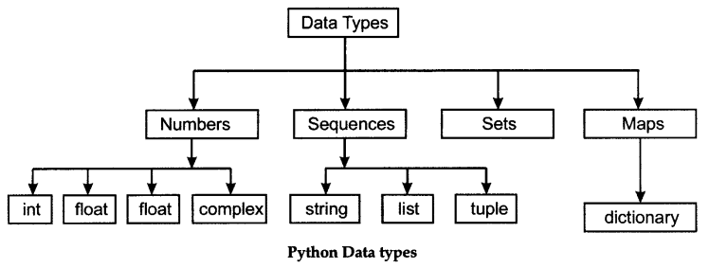
Python Data Types
To find out the type of a variable, use type() function

Slide 17
Basic Data Types
Data Type | Type() | Example
Integer | int | 0, 9, -5, 145
Float | float | 0.0, 9.5, -5.9, 1.7e-10 (scientific notation)
Complex |  | 4+3j, 8.0+4.6j
Boolean | bool | True, False
Byte | bytes
Date | datetime | import datetime today = datetime.datetime.now() x = datetime.datetime(2019, 6, 2)
None | NoneType | x = None, A null value.

Slide 18
Compound Data Types
Type | Nature | Mutable | Example | Notes
String | Ordered sequence | Immutable | Greeting = “Hello, world!” | Slicing: [start:stop:step]
range | Ordered sequence | Immutable | x = range(2, 10, 2) | range(start, stop, step) compare with np.arange()
Tuple | Ordered sequence | Immutable | x = 1, “Hi”, 10.5
List | Ordered sequence | Mutable | X = [2, 4, 11, “New”] | Slicing: [start:stop:step] Compare with nparray
Set | Unordered collection | Mutable | S = {“Apple”, “Strawberry”] | Can’t have duplicate members
Dict | Unordered Mapping | Mutable | x = {“name” : ”Jay”, “age” : 50} | key:value pair Keys must be unique

Slide 19
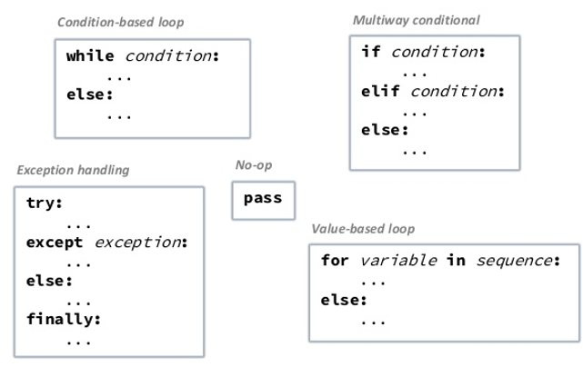
Control Flows
break
Continue

Slide 20
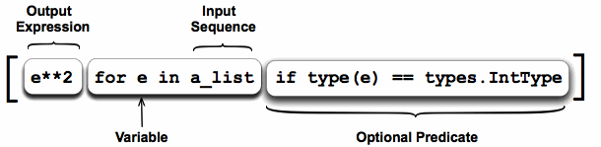
List Comprehensions
Create a new list from an existing list without using a for loop
Simplicity - > Beauty
Parsimony -> Efficiency

Slide 21
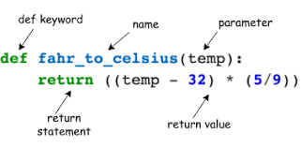
Function

Slide 22
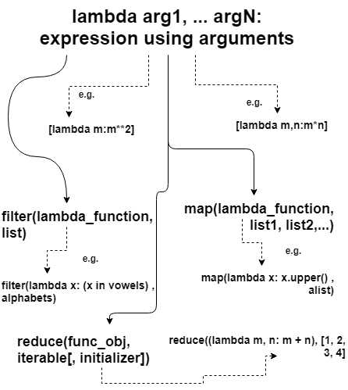
Lambda Function
Inline, anonymous function
Multiple inputs/arguments
Single output/expression
Simplicity -> Beauty
Parsimony -> Efficiency

Slide 23
IO
User Input
X = input(“Please enter a number:”)
File I/O
f = open(“abc.txt)
f.read()
f.readline()
f.close()

Slide 24
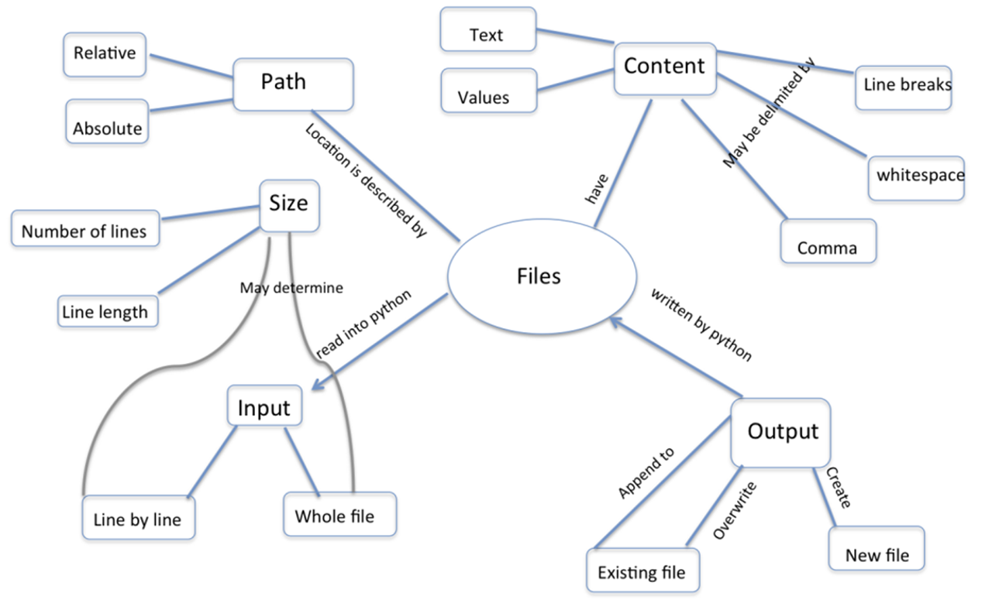
IO

Slide 25
3. Three Pillars

Slide 26
Three Pillars of Python for Data Analytics
Pillar 1
Numpy
Pillar 2
Matplotlib
Pillar 3
Pandas
array
pyplot
data frame

Slide 27
NumPy
Homogeneous multidimensional array (nparray)
Import numpy as np
np.array([2,3,5,6]) – convert a list to an array
np.arrange(start, stop, step) – generate an array

Slide 28
The Matplotlib Object Hierarchy
pyplot
Figure 1
Axes 1
Axes n
Figure m
Axes 1
State-Machine Environment
Figure
Axes
Axis X
Axis Y
Axis
X label, Y label
Title, Legend,
X limit, Y limit, etc.

Slide 29
Two Styles of Coding – Choose One
Procedural Style
Object Oriented Style
Matlab style
Methods from pyplot module
Use figure object
Use axes object
More control

Slide 30
pyplot Procedural Style
# assuming there is only one figure and one axes (default)
x = np.linspace(0,2,100)
plt.plot(x, x, label="linear") # legend
plt.plot(x, x**2, label="quardratic")
plt.plot(x, x**3, label="cubic")
plt.xlabel("X") # X axis label
plt.ylabel("Y") # Y axis label
plt.title("This is a Test") # the title of the Axes
plt.legend() # the legend of the axes

Slide 31
Object-Oriented Style
x = np.linspace(0,2,100)
# one figure can have multiple axes’s. Here we create one axes.
fig, ax = plt.subplots()
ax.xlabel = "X"
ax.plot(x,x, label="Linear")
ax.plot(x, x**2, label="Quadratic")
ax.plot(x,x**3, label="cubic")
ax.set_xlabel("X")
ax.set_ylabel("Y")
ax.set_title("Sample")
ax.legend()

Slide 32
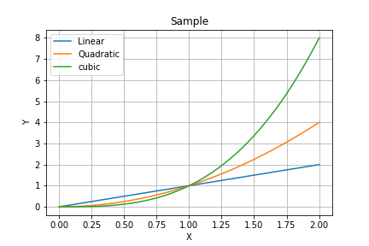
Different Styles, Same Results

Slide 33
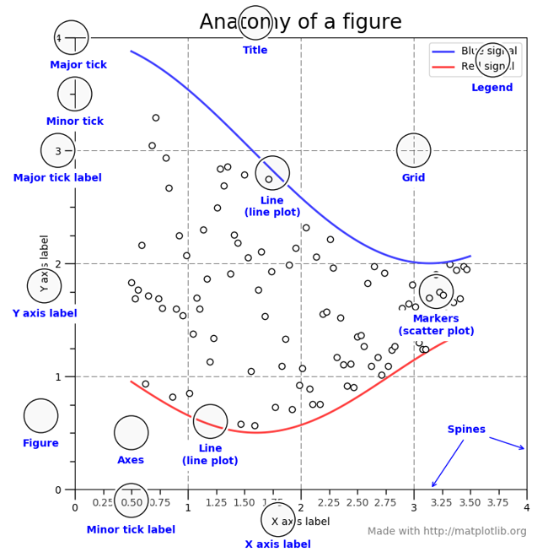

Slide 34
Seaborn
Wrap around Matplotlib
Hide complexity of Matplotlib
High-level API
Static Charts (not dynamic/interactive)
For interactive viz, use Plotly/Plotly-Express

Slide 35
Resources
Numpy Tutorial
https://docs.scipy.org/doc/numpy/user/quickstart.html
Matplotlib Tutorial
https://matplotlib.org/tutorials/introductory/pyplot.html#sphx-glr-tutorials-introductory-pyplot-py

Slide 36
4. Two Partners

Slide 37
Plotly – Interactive Data Visualization
plotly.graph_objects contains the main components of a plot:
Figure contains all info for the visualization ( data and layout)
Layout contains all info for styling
Scatter, Bar, Heatmap, etc, express different type of graphs.
NOTE: These objects can always be swapped with python dicts
Minimal plotly example:
import plotly.graph_objs as go
go.FigureWidget (data=[dict(x=[0,1,2], y=[3,4,2]

Slide 38
Plotly Express
Wrapper for Plotly
High-level API
Consistent syntax across different charts
Integrate with Dash for web dashboarding

Slide 39
Dash
Python Framework for Analytical Web App
Frontend: JS (Plotly/Plotly Express, React)
Backend: Flask
Minimal example
import dash
import dash_html_components as html
app = dash.Dash()
app.layout = html.Div('Hello World!' )
if __name__ == '__main__’:
app.run_server()

Slide 40
Incorporate Visualization
import dash_core_components as dcc
import plotly.graph_objs as go
app.layout = html.Div([
html.H1('Hello EuroPython!' ),
dcc.Graph(
id='my-first-graph' ,
figure=dict(data=[dict(x=[0,1,2], y=[3,4,2])]),
)
])

Slide 41
Callbacks for Interactivity
from dash.dependencies import Input, Output
app.layout = html.Div([
dcc.Input(id='my-id', value='initial value' , type='text'),
html.Div(id='my-div')
])
@app.callback (
Output(component_id ='my-div', component_property ='children'),
[Input(component_id ='my-id', component_property ='value')]
)
def update_output_div (input_value):
return 'You\'ve entered "{}"' .format(input_value)

Slide 42
Style Sheet
app.css.append_css({'external_url' : 'https://codepen.io/chriddyp/pen/bWLwg
P.css'})
app.layout = html.Div([
dcc.Input(id='my-id', value='initial value' , type='text'),
html.Div(id='my-div'),
],
className='container',
)

Slide 43
Summary
Html components (HTML tags)
Core components (sliders, buttons, graphs)
Plotly.py graph objects
Callbacks (connect the pieces)
CSS classes for pretty layout and styling

Slide 44
Summary - MVC
View
(html, core, graph, style)
Controller (callbacks)
Model (dataframe)

Slide 45
Deployment Options
1. Don't bother (1-person, local use only)
2. Know Flask
3. PaaS (e.g. Heroku, Digital Ocean)
4. Ask your engineer friend (aka Stack Overow)
5. Ask Plotly (probably not for free)

Slide 46
Additional Considerations
External JS
Caching
Optional WebGL graphs for billion-point visualization (actually >15K)
Live updates
Authentication

Slide 47
Parting Thought
Knowledge cannot be taught;
It can be shared and learned.

Slide 48
Where to Go From Here

Slide 49
Python Programming
Continue to learn
Try PythonAnywhere.com
Jupyter Notebooks
Learn & use Markdown
Build Kaggle portfolio
Software Engineering
Learn & use version control
Learn SW methodology
Learn and practice more
Data Processing
Data visualization
Inferential Statistics
Communication
Presentations & reports
Collaboration
Humility
Humanity
Learning Culture
Curiosity
Continuous learning

Slide 50
Backup Slides

Slide 51
Data Visualization - Python vs COTS
Tableau
Power BI
Qlik
Dash
Bokeh
Seaborn
Plotly
Matplotlib
Pandas
Numpy
Plotly Express

Slide 52
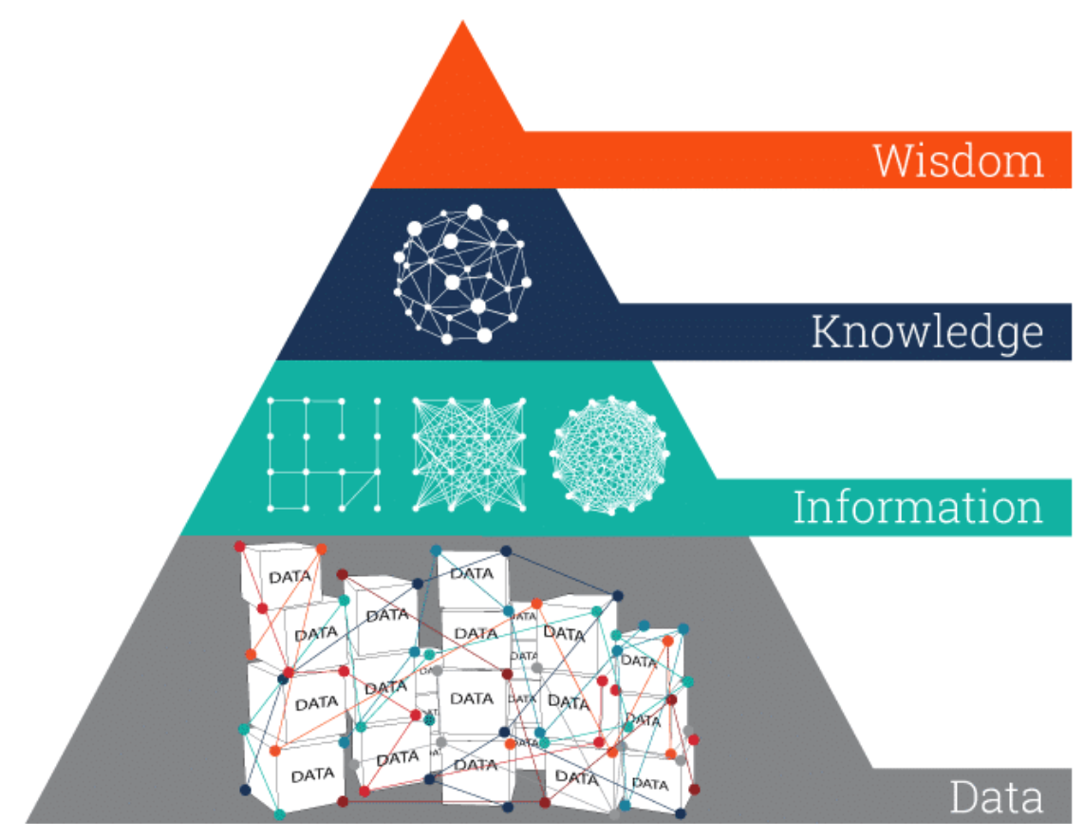
Theoretical Foundation DIKW Hierarchy (Zeleny, 2006)
Ethics
knows why
Collaborations
knows how
Visualizations
knows what
Data Prep
knows nothing
Image adapted from: https://www.ontotext.com/knowledgehub/fundamentals/dikw-pyramid/
Zeleny, M. (2006). From knowledge to wisdom: On being informed and knowledgeable, becoming wise and ethical. International Journal of Information Technology & Decision Making, 5(04), 751-762.

